Slide 1
General Biology (Biol1012)
Lecture Slides
Chapter 2: Biomolecules
1

Slide 2
Chapter 2: Biological Molecules
At its most fundamental level, life is made up of matter
Matter is any substance that occupies space and has mass.
Elements are unique forms of matter with specific chemical and physical properties that cannot be broken down into smaller substances by ordinary chemical reactions.
There are 118 elements, but only 92 occur naturally.
How many elements are represented in life?
Of the 92 naturally occurring elements, only fewer than 30 are found in living cells
The smallest component of an element that retains all of the chemical properties of that element is called an Atom
All atoms contain the subatomic particles:
protons
electrons, and
neutrons (H is the exception, lacking neutrons)

Slide 3
A proton:
is a positively charged particle (+1)
located in the nucleus (core) of the atom
has a mass of 1 dalton
An electron:
is a negatively charged particle (-1)
travels in the space around the nucleus
has a negligible mass
A neutron:
does not have a charge (0)
located in the nucleus (core) of the atom
has a mass of 1 dalton

Slide 4
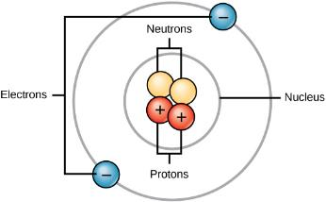
Atoms are made up of protons and neutrons located within the nucleus, and electrons surrounding the nucleus.
Atoms of each element contain a characteristic number of protons and electrons. The number of protons determines an element’s atomic number and is used to distinguish one element from another.
The differences in chemical reactivity between the elements are based on the number and spatial distribution of an atom’s electrons.
Atoms that chemically react and bond to each other form molecules. Molecules are simply two or more atoms chemically bonded together. Logically, when two atoms chemically bond to form a molecule, their electrons, which form the outermost region of each atom, come together first as the atoms form a chemical bond.

Slide 5
Chemical bonds are interactions between atoms, ions or molecules that enable the formation of molecules (a force that holds them together).
Major types of bonds or interactions:
Ionic bond: formed from the electrostatic attraction between oppositely charged ions in a chemical compound.
Because the number of electrons does not equal the number of protons, each ion has a net charge.
Cations are positive ions that are formed by losing electrons.
Negative ions are formed by gaining electrons and are called anions.
Movement of electrons from one element to another is referred to as electron transfer

Slide 6
2. Covalent bond - form when an electron is shared between two atoms
Covalent bonds are the strongest and most common form of chemical bond in living organisms
When one pair of electrons are shared, it forms a single bond
When two pairs of electrons are shared, it forms a double bond
When three pairs of electrons are shared, it forms a triple bond

Slide 7
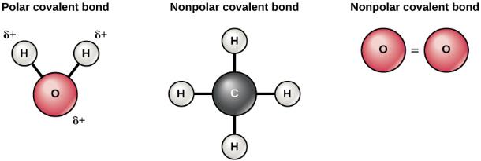
There are two types of covalent bonds: nonpolar covalent bonds and polar covalent bonds
Nonpolar covalent bonds are formed when the electrons are shared equally
Polar covalent bonds are formed when the electrons are not shared equally, they spend more time closer to one nucleus than to the other nucleus. This gives the atom where the electron spends more time a small negative charge, and the atom missing the electron more a small positive charge

Slide 8
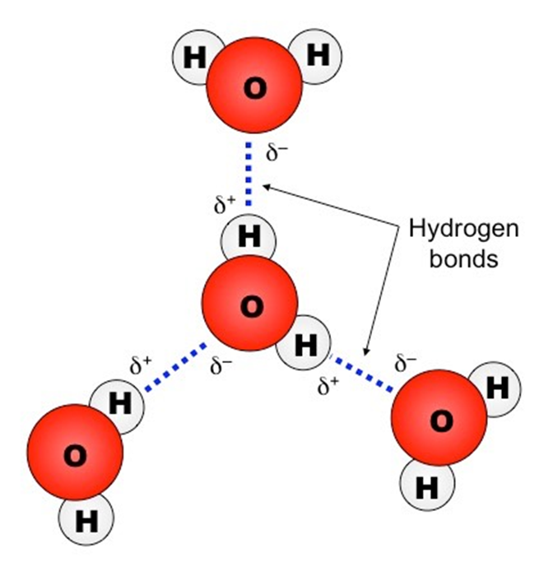
Hydrogen Bond:
When polar covalent bonds containing hydrogen form, the hydrogen in that bond has a slightly positive charge because hydrogen’s electron is pulled more strongly toward the other element and away from the hydrogen.
Because the hydrogen is slightly positive, it will be attracted to neighboring negative charges. When this happens, a weak interaction occurs between the δ+ of the hydrogen from one molecule and the δ– charge on the more electronegative atoms of another molecule, usually oxygen or nitrogen, or within the same molecule. This interaction is called a hydrogen bond

Slide 9
Important Molecules of life
Organic molecules:-
carbohydrates
lipids
Proteins
nucleic acids (DNA, RNA)
Vitamins
Inorganic molecules:
water
oxygen
carbon dioxide
mineral salts

Slide 10
Macromolecules
Large molecules necessary for life are built from smaller organic molecules and are called biological macromolecules
There are four major classes of biological macromolecules:
Carbohydrates
Lipids,
Proteins, and
Nucleic acids (DNA and RNA).

Slide 11
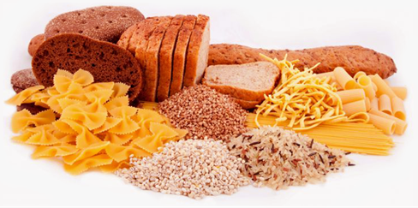
Carbohydrates
Also called saccharides
most abundant organic molecules in our biosphere
composed of carbon, hydrogen and oxygen
General formula Cn(H₂0)n, where n is the number of carbon atoms in the molecule
Functions
Primary source of energy (glucose)
Energy storage (glycogen, starch)
Structural component of
cell membrane (Glycoproteins and Glycolipids),
Cell wall of plants (cellulose).
cell wall of bacteria (Peptidoglycan),
cell wall of fungi (Chitin),
exoskeleton of many insects are made up of carbohydrates

Slide 12
Cont’d
Classification of Carbohydrates
Based on the number of sugar units carbohydrates can be classified as:
Monosaccharides – composed of one sugar unit
Oligosaccharides: Composed of 2 to 20 sugar units and includes
Disaccharides (composed of two sugar subunits), Trisaccharides… etc
Polysaccharides – Composed of more than 20 sugar units

Slide 13
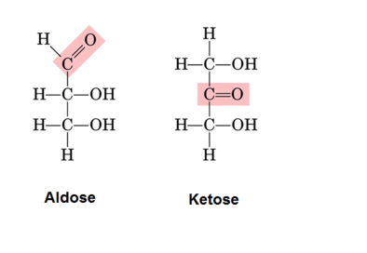
Cont’d
Monosaccharides
(mono– = “one”; sacchar– = “sweet”) are simple sugars the most common of which is glucose
Represented by the general formula (CH₂O)n where n is 3 -7
Most monosaccharide names end with the suffix –ose
consists of a carbon chain with a number of hydroxyl (OH) groups and either an aldehyde group or a ketone functional group

Slide 14
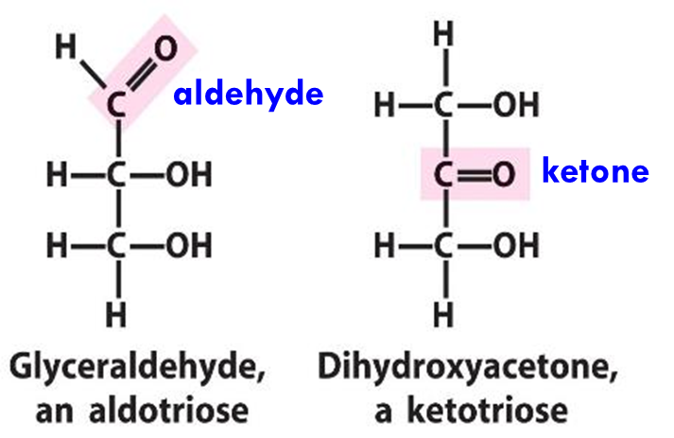
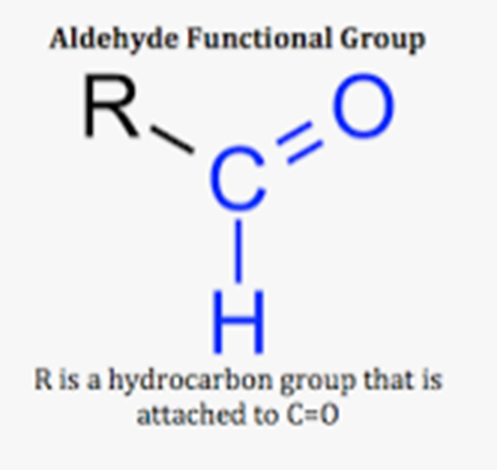
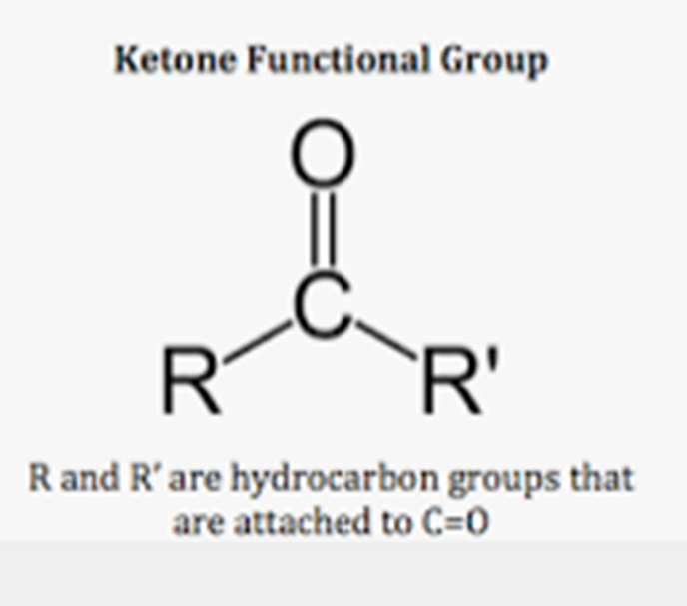
Cont’d
Monosaccharides have common (trivial) names and systematic names.
Systematic name indicates both the number of carbon atoms present and functional group (aldehyde or ketone).
A sugar that bears an aldehyde group is called an aldose where as a sugar with a ketone group is a ketose.
For example, glyceraldehyde is aldotriose and dihydroxyacetone is ketotriose

Slide 15
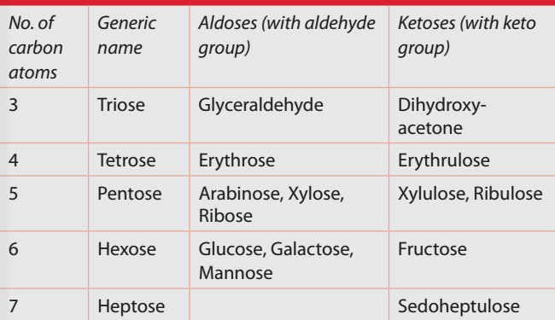
Depending on the number of carbons in the sugar, they also may be known as

Slide 16
Examples of Monosaccharides
Glucose: the most predominant sugar in human body. It is the major source of energy
Galactose is a constituent of lactose (milk sugar) and glycoproteins
Fructose is the constituent of sucrose, the common sugar
Although glucose, galactose, and fructose all have the same chemical formula (C₆H₁₂O₆), they differ structurally and chemically (and are isomers)
Isomers are compounds that have the same chemical formula but different structures
Stereoisomers have the same chemical formula but differ in the position of the hydroxyl groups on one or more of their asymmetric carbons.
Epimers are stereoisomers that differ in the position of the hydroxyl group at only one asymmetric carbon. For example, glucose and galactose are epimers that differ at carbon 4.

Slide 17
H
H
H
H
C
OH
C
O
C
O
C
O
Structural
isomer
H
C
OH
Stereo-
isomer
H
C
OH
HO
C
H
HO
C
H
HO
C
H
H
C
OH
H
C
OH
Epimers
HO
C
H
H
C
OH
H
C
OH
H
C
OH
H
C
OH
H
C
OH
H
C
OH
H
H
H
Fructose
Glucose
Galactose
17

Slide 18
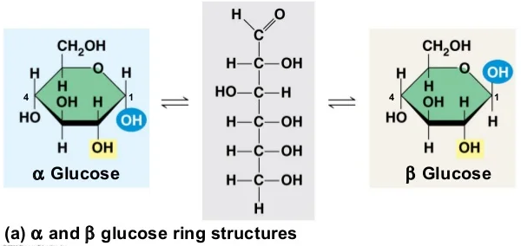
Ring structure of carbohydrates
Monosaccharides with five or more carbons exist predominantly in a ring (cyclic) form
In ring structures, the aldehyde or ketone group reacts with a hydroxyl group in the same molecule and results in α and β forms are called anomers
If the hydroxyl group is below carbon number 1 in the sugar, it is said to be in the alpha (α) position, and if it is above the plane, it is said to be in the beta (β) position.
If the hydroxyl group is below carbon number 1 in the sugar, it is in the alpha (α) position, and if it is above the plane, it is in the beta (β) position

Slide 19
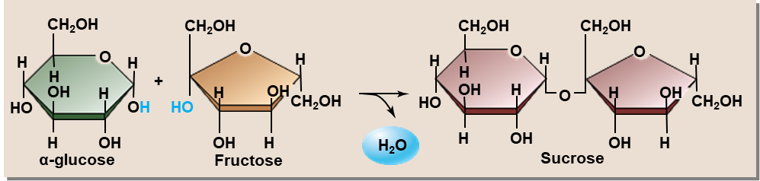
Disaccharides
Disaccharides (di– = “two”) form when two monosaccharides undergo a dehydration reaction (also known as a condensation reaction or dehydration synthesis).
During this process, the hydroxyl group of one monosaccharide combines with the hydrogen of another monosaccharide, releasing a molecule of water and forming a covalent bond.
A covalent bond formed between a carbohydrate molecule and another molecule (in this case, between two monosaccharides) is known as a glycosidic bond
Common disaccharides include lactose, maltose and sucrose
Lactose = glucose + galactose (found in milk)
Maltose = glucose + glucose (malt sugar)
Sucrose = glucose + fructose (table sugar)

Slide 20
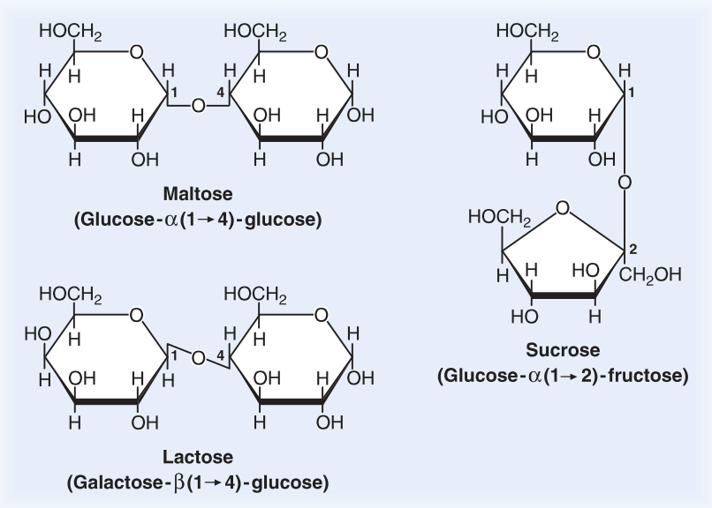
Glycosidic bonds (also called glycosidic linkages) can be of the alpha or the beta type.
An alpha bond is formed when the OH group on the carbon-1 of the first monosaccharide is below the ring plane, and
a beta bond is formed when the OH group on the carbon-1 is above the ring plane.

Slide 21
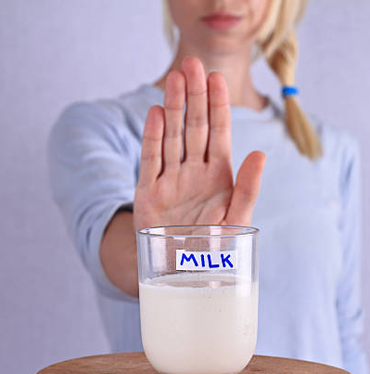
Cont’d
Lactose intolerance
Lactose is digestible by most humans by lactase enzyme present in the small intestine to galactose and glucose.
5% of people from Scandinavia and 90% of Asian adults suffer from lactose intolerance – a deficiency in the enzyme lactase.
For those with the deficiency:
Lactose accumulates in the small intestine, Degraded by intestinal bacteria producing CO₂, hydrogen gas, and organic acid Symptoms
Bloating, Nausea, Cramping, Diarrhea

Slide 22
Polysaccharides
A long chain of monosaccharides linked by glycosidic bonds is a polysaccharide (poly- = “many”) through dehydration synthesis
E.g. Starch, Glycogen, Celullose.
Major classes of polysaccharides:
Starch: is the stored form of sugars in plants and is made up of a mixture of amylose and amylopectin (both polymers of glucose).
Plants are able to synthesize glucose, and they store the excess glucose, beyond their immediate energy needs, as starch in different plant parts, including roots and seeds.
The starch in the seeds provides food for the embryo as it germinates and can also act as a food source for humans and animals.

Slide 23
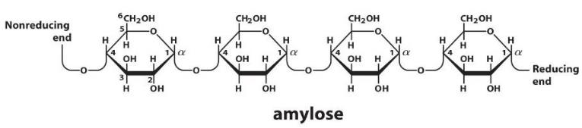
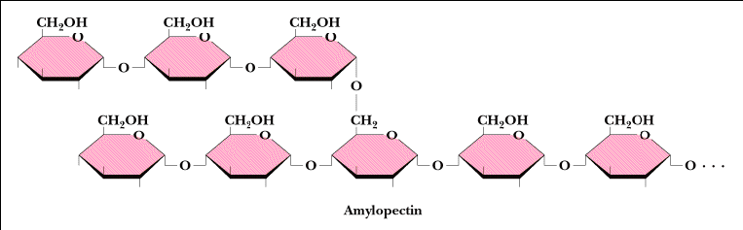
Structure of starch
In starch, glucose monomers are joined by α 1-4 or α 1-6 glycosidic bonds. The numbers 1-4 and 1-6 refer to the carbon number of the two residues that have joined to form the bond.

Slide 24
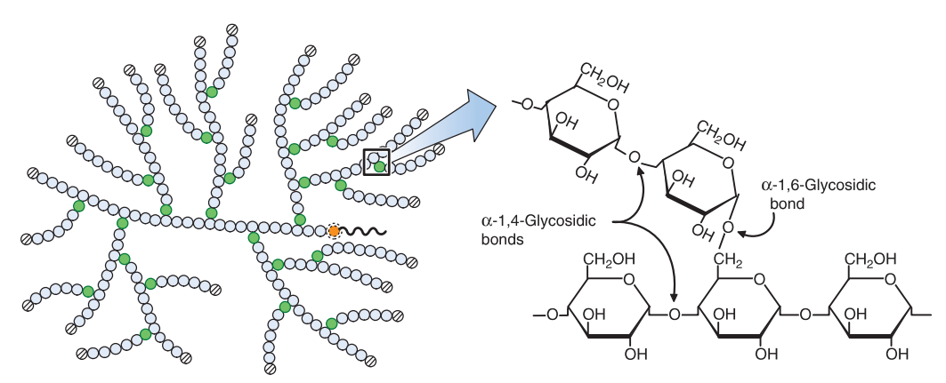
Glycogen: is the storage form of glucose in humans and other vertebrates and is made up of monomers of glucose.
Glycogen is the animal equivalent of starch and is a highly branched molecule usually stored in liver and muscle cells.
Whenever blood glucose levels decrease, glycogen is broken down to release glucose in a process known as glycogenolysis.

Slide 25
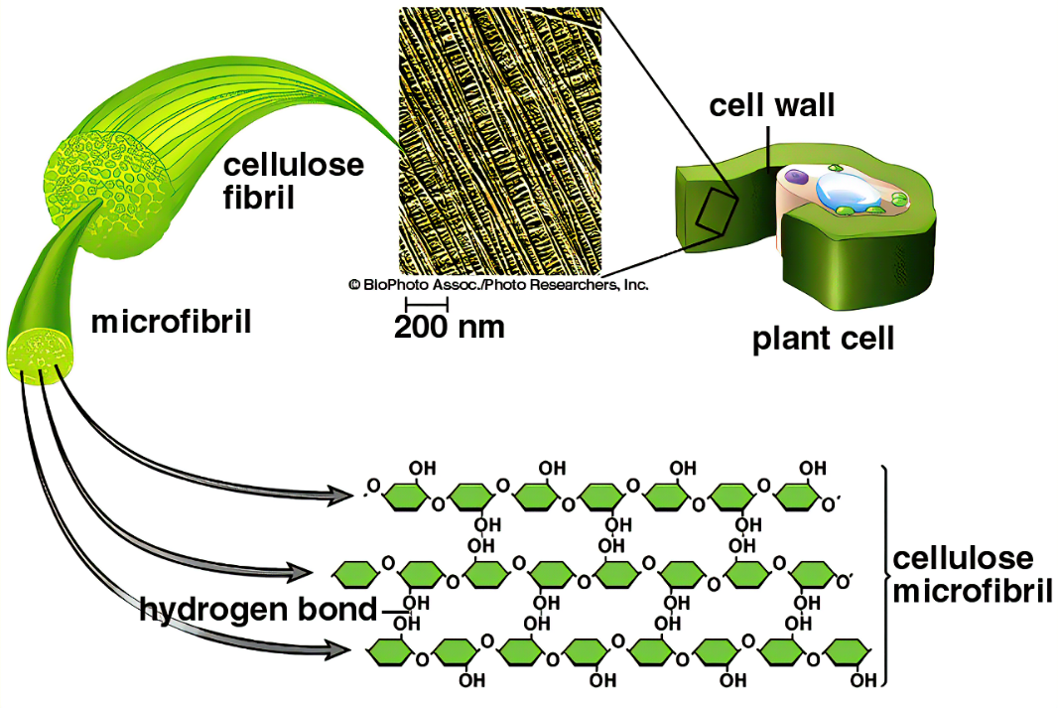
Cellulose:
Cellulose is made up of glucose monomers that are linked by β 1-4 glycosidic bond
make cell wall of plants providing structural support to the cell.
Wood and paper are mostly cellulosic in nature.

Slide 26
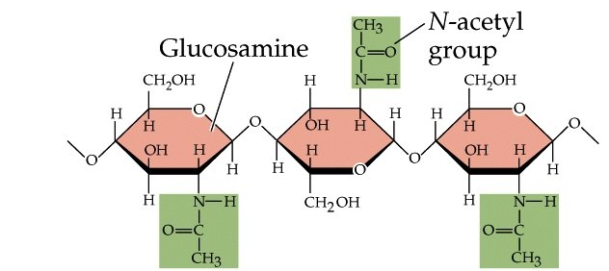
Chitin
is a polysaccharide-containing nitrogen.
It is made of repeating units of N-acetyl-β-d-glucosamine, a modified sugar.
Make the structure of fungal cell wall and insects exoskeleton

Slide 27
Lipids
Lipids
include a diverse group of compounds that are largely nonpolar in nature (water-insoluble)
They are esters of fatty acids and alcohol (glycerol or chains of alcohols).
are highly soluble in organic solvents (ether, chloroform, and acetone).
Functions of lipids
Make structural components in cell membranes (e.g., phospholipids and sphingolipids)
For long term storage of energy. e.g. fats and oils
Serve as chemical signals (hormones), vitamins, or pigments.
Form protective or waterproofing functions.
provide insulation from the environment for plants and animals
Lipids include fats, oils, waxes, phospholipids, and steroids.

Slide 28
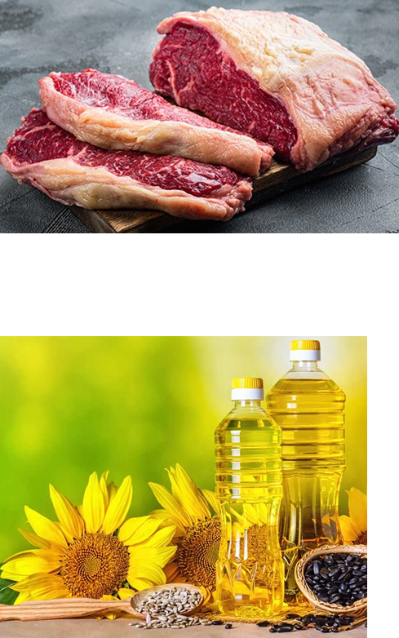
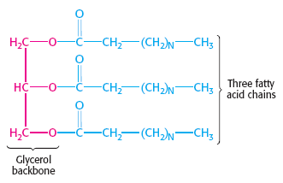
Fats and Oils
Also called Triacylglycerols
consist of three fatty acid chains esteriﬁed to a glycerol backbone.

Slide 29
Fatty acids
are hydrocarbons, which terminate with carboxylic acid groups = R-COOH
Most have an even number of carbon atoms
Chain length = 12 to 24, most with 16 or 18 carbon atoms.
Amphipathic – have both hydrophobic and hydrophilic parts
R-COOH
Fatty acids may be saturated or unsaturated.

Slide 30
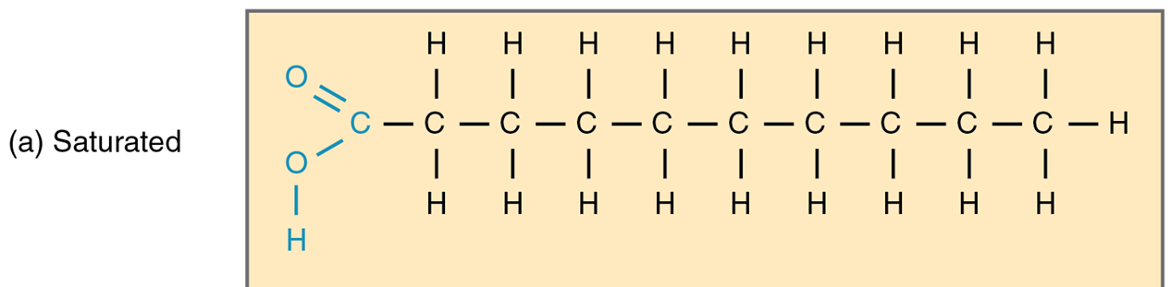
Saturated fatty acids
no double bonds between carbon atoms. general formula CH₃(CH₂)nCOOH, where n is an even number
are saturated with hydrogen, i.e. the number of hydrogen atoms attached to the carbon skeleton is maximized
Have higher melting point and are solid at room temperature. E.g. fatty acids of animal origin
saturated fats contribute to plaque formation in the arteries = Atherosclerosis- cause of heart attack, stroke, Gangrene

Slide 31
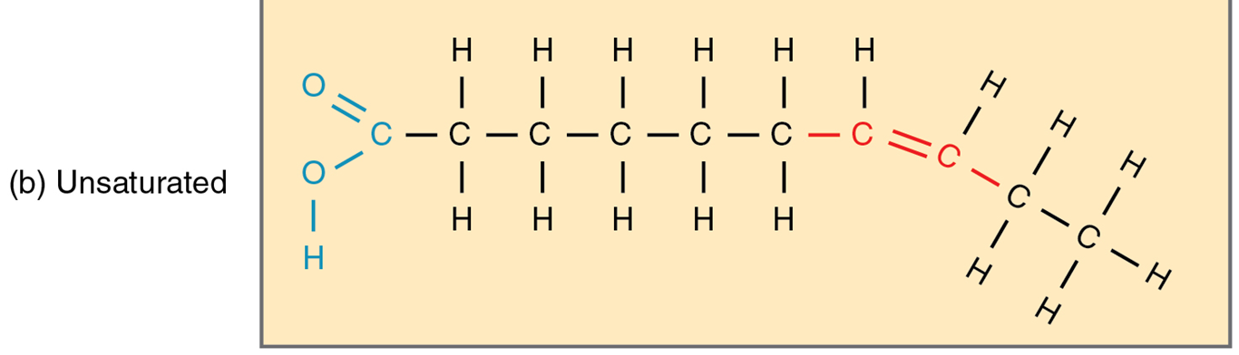
Unsaturated fatty acids
contain a double bond in their carbon-carbon chain
Can be either
Monounsaturated fatty acids: have one double bond
Polyunsaturated fatty acids: have two or more double bonds.
Have Lower melting points than saturated fatty acids and thus Liquid at room temperature. E.g. Fatty acids of plant origin

Slide 32
Essential and Non-Essential fatty acids
Essential fatty acids are fatty acids that are required but not synthesized by the human body; therefore they must be supplemented through the diet
There are two known essential fatty acids for humans: omega-3 fatty acid and omega-6 fatty acid
Omega-3 fatty acids are found in salmon, trout, and tuna; they are important in brain function, normal growth/development, and may prevent heart disease, and certain cancers
Non Essential Fatty acids are fatty acids that can be synthesized in the body.
Organisms such as plants and bacteria can synthesize all the fatty acids they require

Slide 33
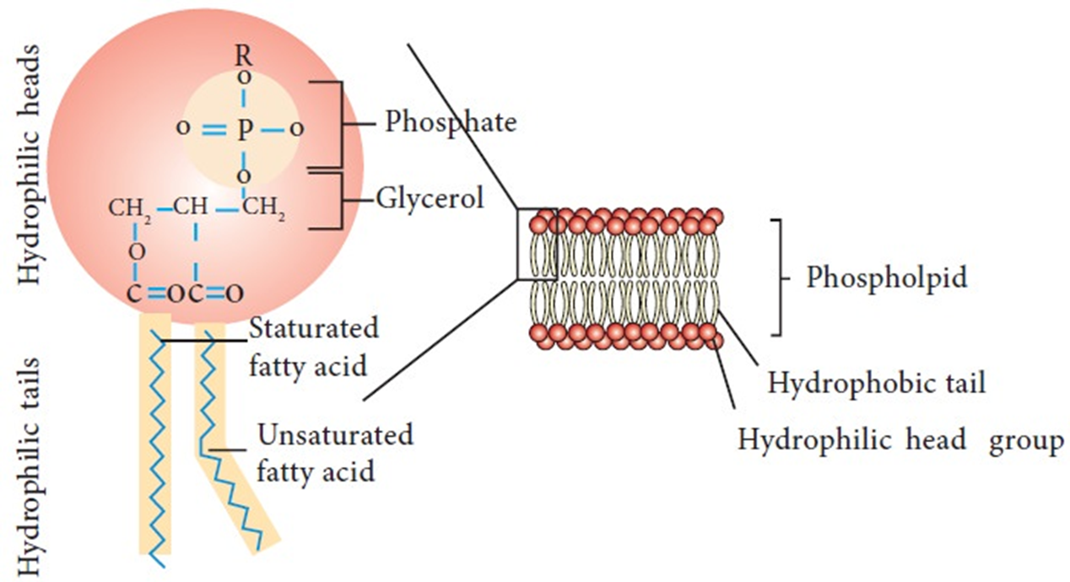
Phospholipids
Are structural components membranes
Composed of glycerol + 2 FA (attached on C1 & C2 of glycerol) + phosphate (attached to C3 of glycerol)
A phospholipid is an amphipathic molecule, meaning it has a hydrophobic and a hydrophilic part. The fatty acid chains are hydrophobic and cannot interact with water, whereas the phosphate-containing group is hydrophilic and interacts with water

Slide 34
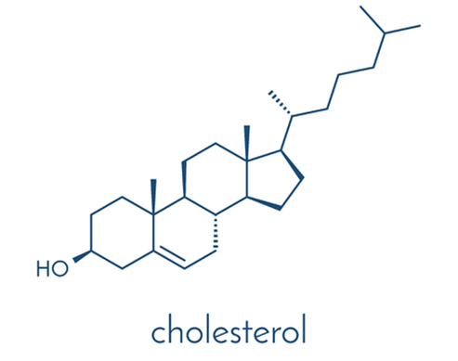
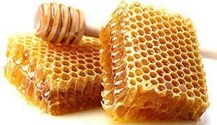
Steroids and Waxes
Steroids have four carbon rings linked together and several of them (like cholesterol) have a short tail
It is synthesized by the liver; and is a precursor of many hormones, of vitamins E and K, and of bile salts
It is a key component of the plasma membrane of animal cells
It is necessary for the proper functioning of the body

Slide 35
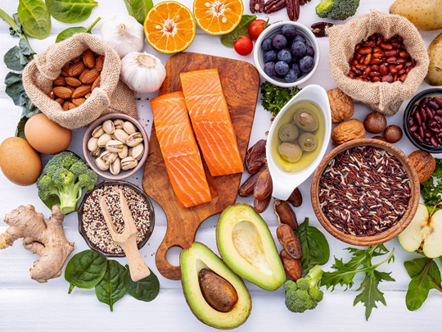
Proteins are the most abundant organic molecules in living systems
Functions
Catalysis= enzymes
Protection and support = collagen, Elastin
Movement = actin, tubulin
Defense = immunoglobulins (antibodies)
Regulation = hormone, Growth factors
Transport = hemoglobin, lipoproteins, Transferrin
Storage = ovalbumin, casein
Stress response = cytochrome P450, metallothionein, heat shock proteins

Slide 36
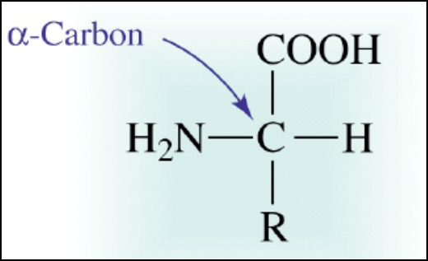
All proteins are made up of different arrangements of the same 20 kinds of amino acids
Amino acids are the monomers that make up proteins
Each amino acid consists of a central carbon atom bonded to an amino group (-NH₂), a carboxyl group (-COOH) and a hydrogen atom
Each amino acid has its own unique R group
The R group is the only difference in structure between the 20 amino acid

Slide 37
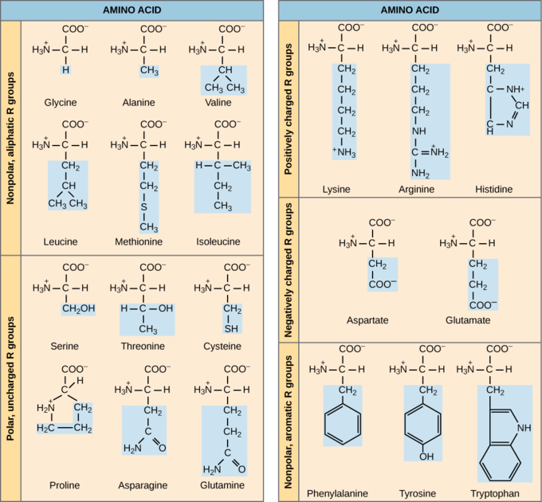

Slide 38
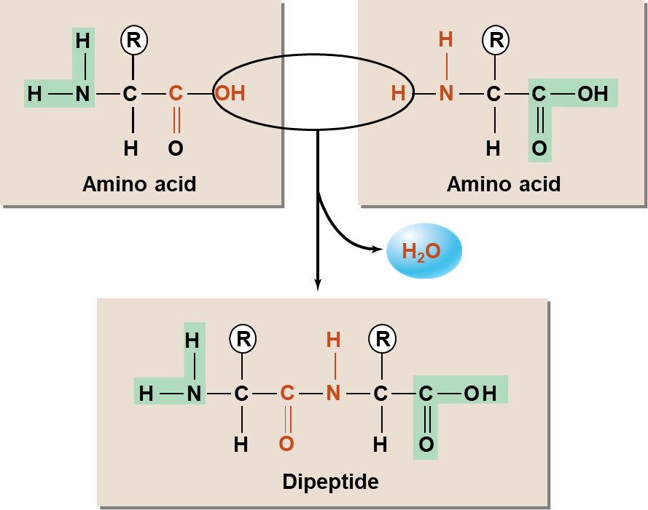
Structure of Proteins
In protein structure, each amino acid is attached to another amino acid by a covalent bond, known as a peptide bond, which is formed by a dehydration reaction
The term polypeptide refers to a polymer of amino acids
The sequence and number of amino acids ultimately determine a protein’s shape, size, and function

Slide 39
Protein structure.....
A protein’s shape is critical to its function
Each protein has its own unique sequence and shape
There are four levels to protein structure:
Primary
Secondary
Tertiary
Quaternary

Slide 40
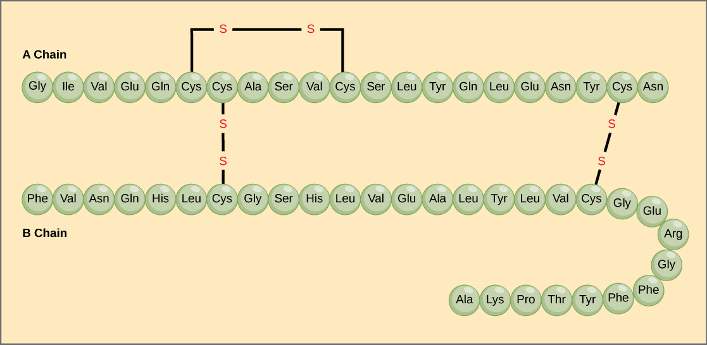
Primary structure:
Refers to genetically determined sequence of amino acids
Amino acids linked by peptide bonds
Millions of different proteins made from the 20 standard amino acids

Slide 41
Primar structure....
A change in nucleotide sequence of the gene’s coding region may lead to a different amino acid being added to the growing polypeptide chain, causing a change in protein structure and function. Example: Sickle cell anemia
In sickle cell anemia, the hemoglobin β chain has a single amino acid substitution, causing a change in protein structure and function. Specifically, the amino acid glutamic acid is substituted by valine in the β chain.
Because of this change of one amino acid in the chain, hemoglobin molecules form long fibers that distort the biconcave, or disc-shaped, red blood cells and assume a crescent or “sickle” shape, which clogs arteries.
sickle-cell anaemia a condition caused by a mutation that affects the structure of the haemoglobin molecules in red blood cells causing the red blood cells to sickle under low oxygen tension.
the haemoglobin molecule alters the triplet from GAG to GTG. This results in the amino acid valine replacing glutamate in the polypeptide chain.

Slide 42
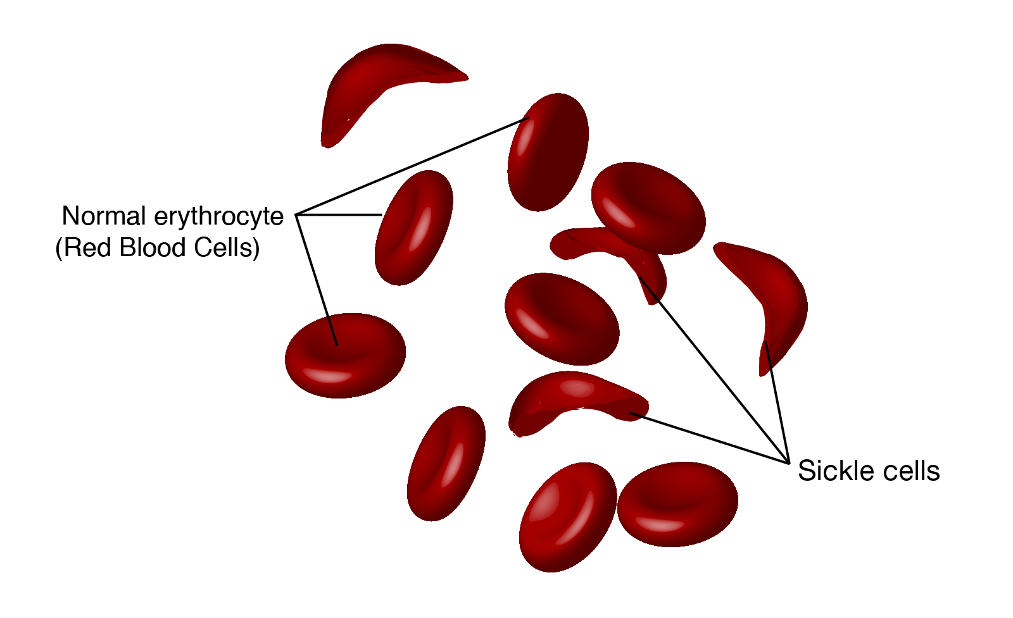
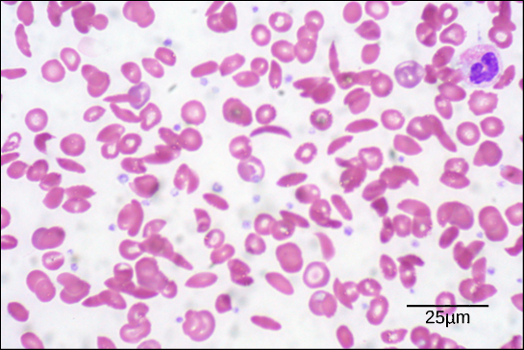
Cont’d
This can lead to myriad serious health problems such as breathlessness, dizziness, headaches, and abdominal pain for those affected by this disease.

Slide 43
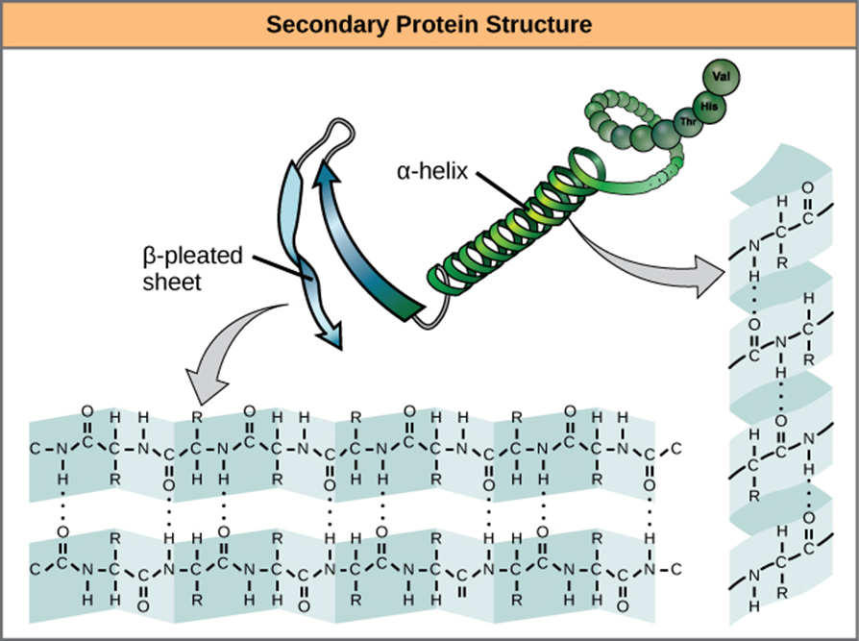
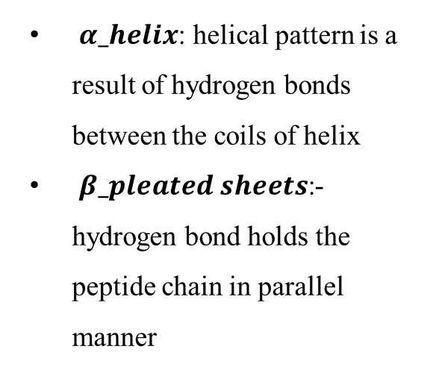
Secondary structure: formed due to interaction of groups in the peptide backbone of primary structure
The structure is stabilized by H-bonds between AA
(beta) sheet
(alpha) helix
$α_helix$: helical pattern is a result of hydrogen bonds between the coils of helix
$β_pleated sheets$:- hydrogen bond holds the peptide chain in parallel manner

Slide 44
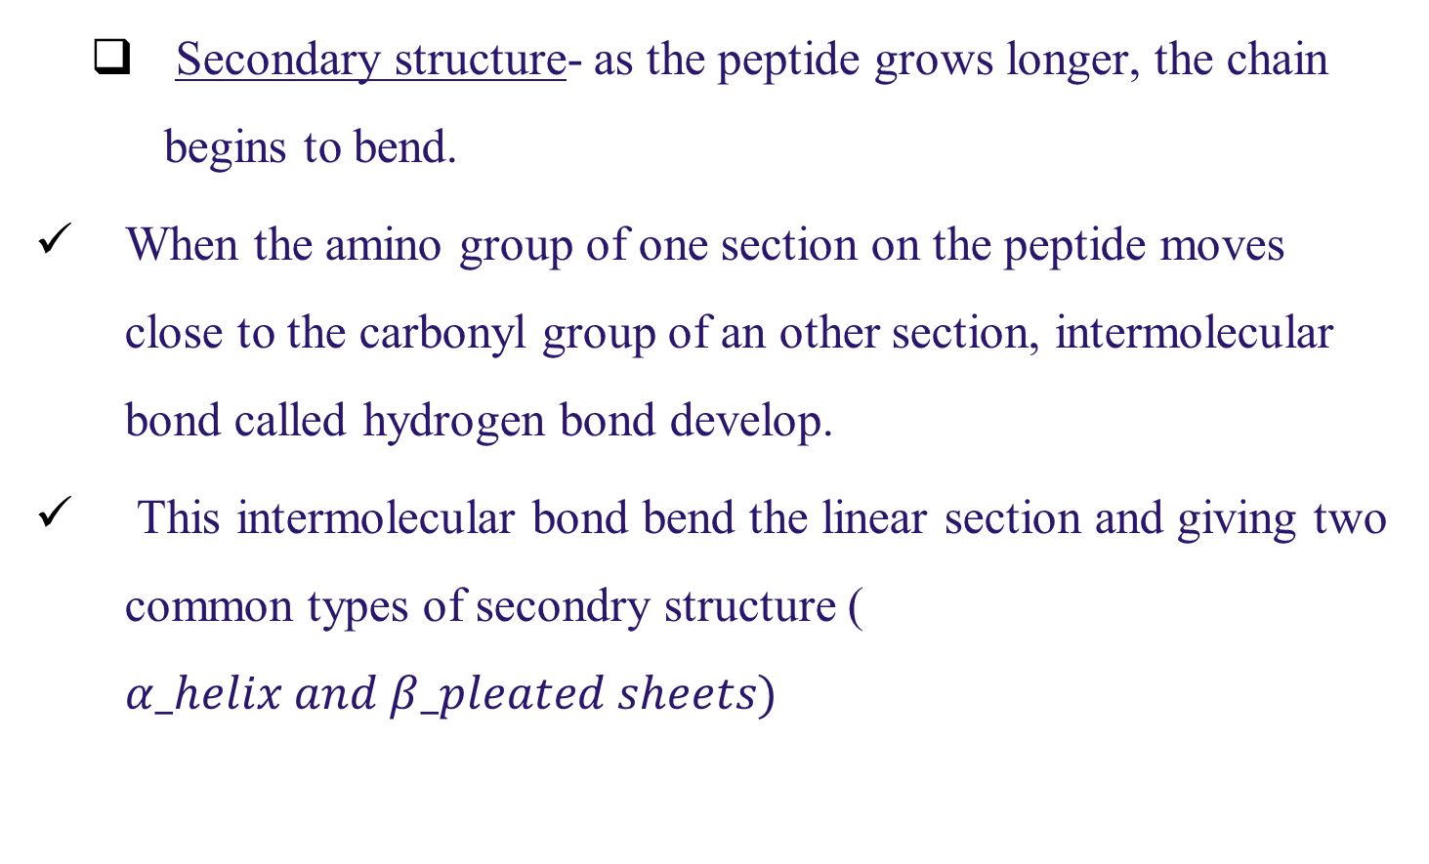
Proteins cont’d
Secondary structure- as the peptide grows longer, the chain begins to bend.
When the amino group of one section on the peptide moves close to the carbonyl group of an other section, intermolecular bond called hydrogen bond develop.
This intermolecular bond bend the linear section and giving two common types of secondry structure ( $α_helix and β_pleated sheets)$

Slide 45
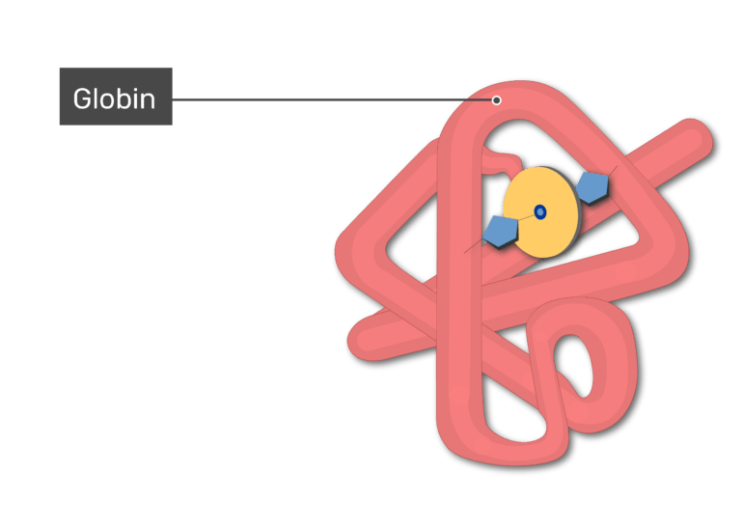
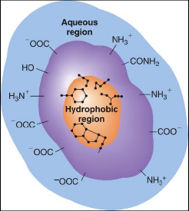
Tertiary structure: final folded shape of a globular protein
Stabilized by a number of forces (H-bonds, covalent bonds, ionic bonds, hydrophobic interactions)
The final level of structure for proteins consists of only a single polypeptide chain

Slide 46
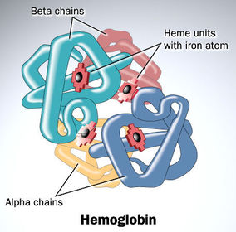
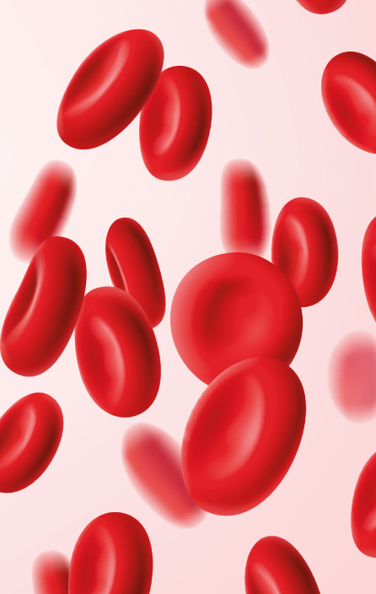
Quaternary structure: arrangement of individual chains (subunits) in a protein with 2 or more polypeptide chains

Slide 47
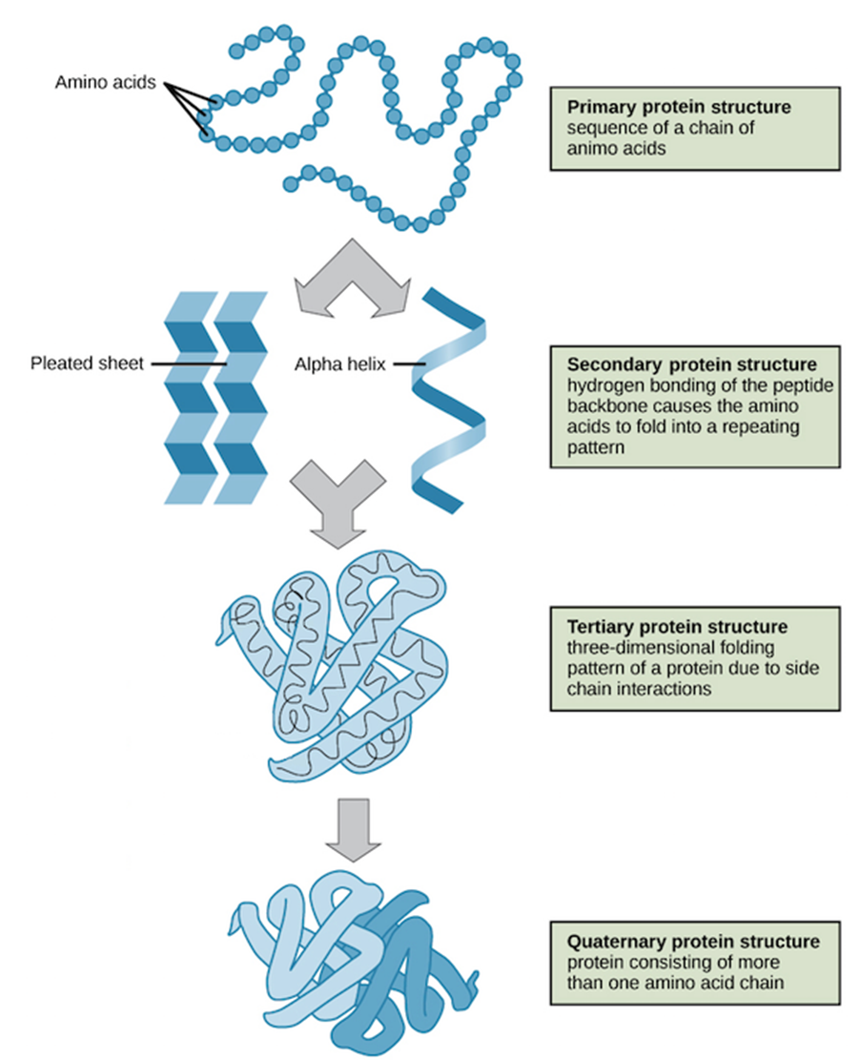

Slide 48
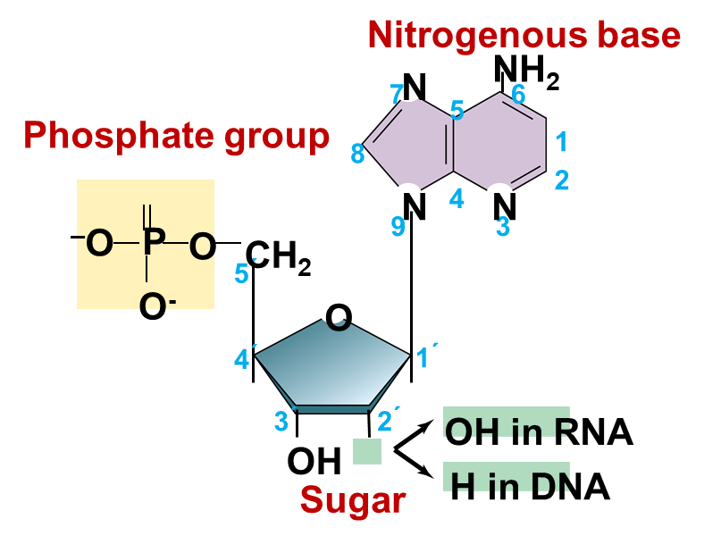
Nucleic Acids
Nucleic acids are polymers of nucleotides that store and transmit genetic information.
The two main types of nucleic acids are:
Deoxyribonucleic acid (DNA) holds the genetic information in all cellular organisms and some viruses.
Ribonucleic acid (RNA) is the genetic material in some viruses
Each nucleotide consists of three parts:
a five-carbon sugar,
a phosphate group, and a
nitrogenous base.

Slide 49
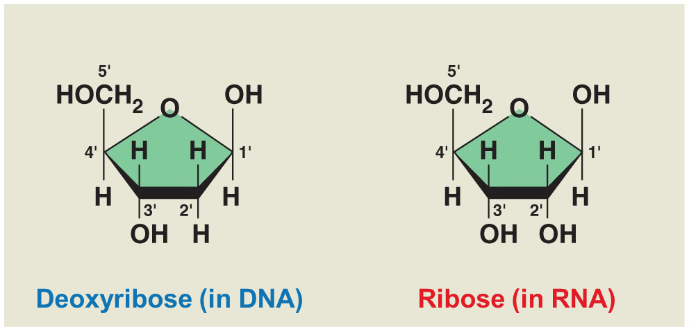
Cont’d
Differences in the structure of the sugars in DNA and RNA
DNA’s sugar, called deoxyribose, has a hydrogen atom at 2` position and contains one oxygen atom fewer overall whereas
RNA’s ribose sugar has a hydroxyl group attached to the 2`‐carbon atom,

Slide 50
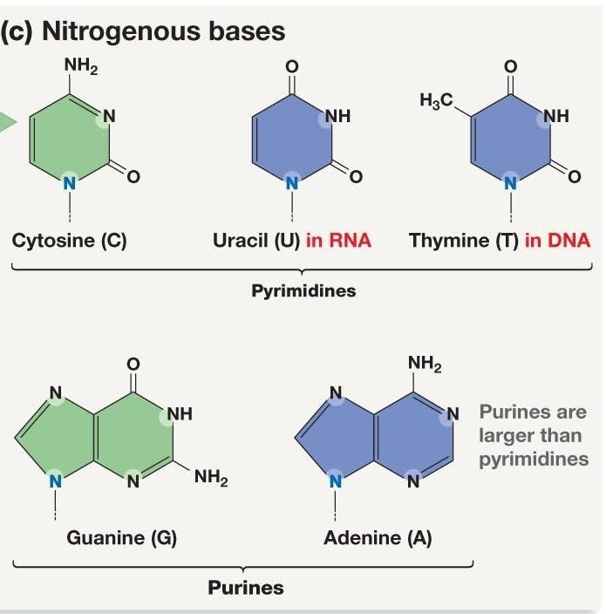
Cont’d
There are two families of nitrogenous bases:
The purines: adenine and guanine in both DNA and RNA.
The pyrimidines: are cytosine and uracil in RNA; uracil is replaced by thymine in DNA.

Slide 51
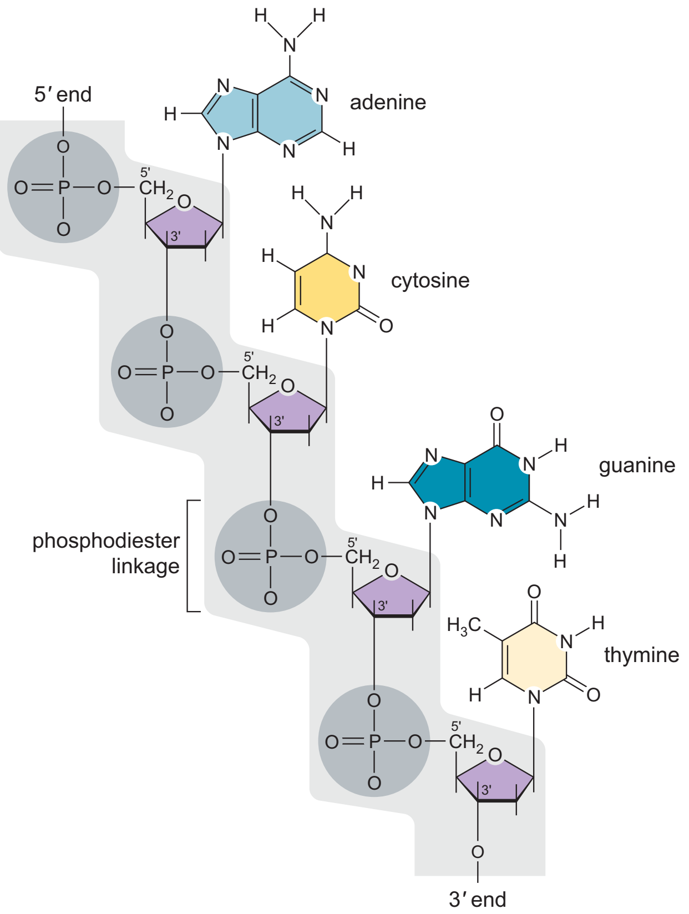
Polynucleotide strands
composed of many nucleotides connected by phosphodiester linkages between 5`‐phosphate group of one nucleotide and 3`‐carbon of the next nucleotide
its backbone is composed of alternating sugars and phosphates and the bases project away from the long axis of the strand.
Nucleic acid polarity
The two ends of the strands are different with
a phosphate group attached to the 5`‐carbon (5’ end)
OH attached to the 3`‐carbon atom of the sugar (3’ end)

Slide 52
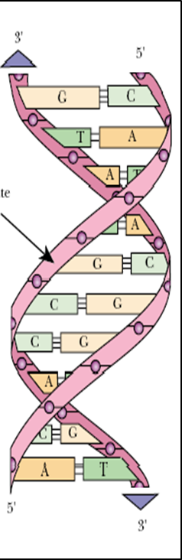
Cont’d
The DNA Double Helix
deduced by James Watson and Francis Crick in 1953.
A DNA molecule has two polynucleotides spiraling around an imaginary axis, forming a double helix
In the DNA double helix, the two backbones run in opposite 5′ → 3′ directions from each other, an arrangement referred to as antiparallel
The strands are joined non-covalently by hydrogen bonding
two hydrogen bonds between Adenine thymine and
three hydrogen bonds between cytosine with guanine
The two polynucleotide strands of a DNA molecules are not identical but complementary.

Slide 53
Cont’d
Ribonucleic Acid (RNA)
RNA similar to DNA except
Contains ribose instead of deoxyribose
Contains uracil instead of thymine
Single stranded
RNA plays many roles in the cell
Messenger RNA (mRNA): DNA encodes the information to make proteins, mRNA relays this info to the structures that make proteins
Ribosomal RNA (rRNA): make structure of Rbosome (Protein synthesizing machinary)
Transfer RNA (tRNA): also involved in protein synthesis by decoding codons in the mRNA into amionoacids

Slide 54
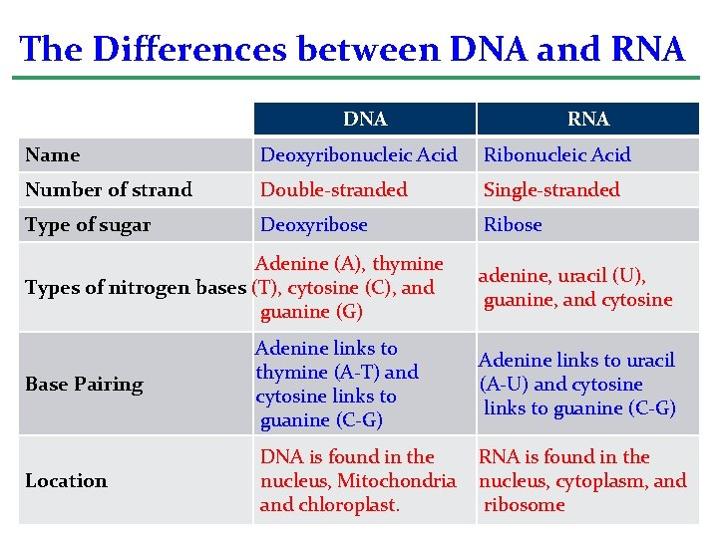
Cont’d

Slide 55
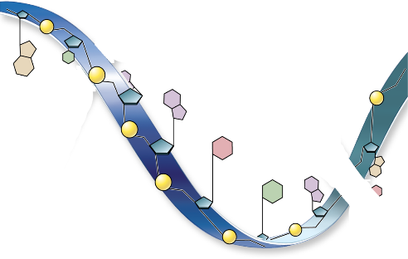

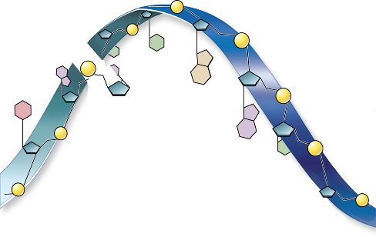

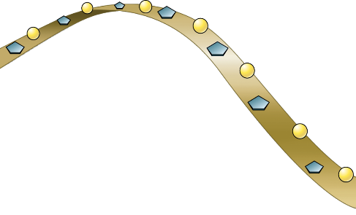
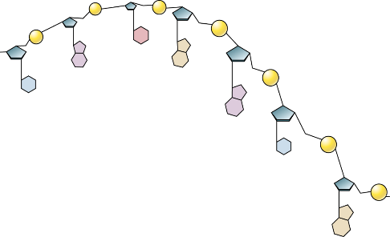
P
P
P
Deoxyribose-
phosphate
backbone
T
T
P
DNA
Double Stranded
ATGC
G
P
A
G
A
P
P
C
P
P
C
A
P
G
Bases
P
T
A
P
P
P
P
Hydrogen bonding
DNA
Occurs between base-pairs
P
P
RNA
Single Stranded
AUGC
P
C
P
A
G
Ribose-phosphate
backbone
U
P
A
Bases
U
P
P
55
RNA
G

Slide 56
Vitamins
Are essential, organic nutrient needed in small amounts in the diet. They can not be synthesized by human body
needed for normal function, growth and maintenance.
are important enzyme cofactors
Inadiquate supply of vitamins leads to deficiency diseases
They are classified as fat-soluble and water-soluble vitamins.
Water-soluble includes: C and B group.
The B complex vitamins may be sub divided into energy releasing (B1, B2, B6, biotin etc) and hematopoietic (folic acid and B12).
Fat-soluble includes: A, D, E and K

Slide 57


Slide 58


Slide 59
Water: a vital compound for life
Why do scientist spend so much time looking for water on other planets?
It is because water is essential to life
Water is the most abundant molecule of life.
Human beings are 70% water, tomatoes are 90% water,
Functions of water
serve as solvent of life
transports compounds
separates charged molecules
dissipates heat
Used as a reactant and as a product in chemical rxns

Slide 60
Water is Polar compound
The hydrogen and oxygen atoms within water molecules form polar covalent bonds
Each hydrogen has a slight positive charge and the oxygen has a slight negative charge
The opposite charges of water molecules are attracted to one another, and is also attracted to other polar molecules
When a substance readily forms hydrogen bonds with water, it can dissolve in water and is referred to as hydrophilic
When a substance does not readily form hydrogen bonds with water, it will not dissolve in water and is referred to as hydrophobic

Slide 61
Properties of Water
Water has many important unique properties that result from water’s polar nature
1. Water has a high heat of vaporization and stabilizes the temperature
The hydrogen bonds in water allow it to absorb and release heat energy more slowly than many other substances
A large amount of energy is required to change the temperature of the water and evaporate it. This helps to keep body temperature constant
The evaporation of water from a surface causes the cooling of that surface

Slide 62

2. Water is an Excellent Solvent
Because water is polar, ionic compounds and polar molecules can readily dissolve in it
Water is therefore referred to as a solvent - a substance capable of dissolving another substance
A “sphere of hydration” serves to keep the charged particles separated or dispersed in the water

Slide 63
3. Water is Cohesive
Cohesion - the attraction of water molecules to other water molecules
Cohesion gives rise to surface tension - the capacity of a substance to withstand rupture when placed under tension or stress
Surface tension allows water to serve as transport medium
Adhesion - the attraction between water molecules and other molecules
The adhesion of water molecules is responsible for transportation of water from the soil to tip of the tree

Slide 64



Slide 65

4. Water expands upon freezing
Solid water is less dense than liquid water
density of water decrease as it cools down
Water has the highest density at 4 degree centigrade
Bodies of water freeze from the top down. This allow organisms to live at the bottom of fresh water lakes, protected from freezing

Slide 66

Minerals
Provide ions for:-Muscle Contraction -Nerve Impulse Conduction -transports substances into- out of cells
Below in the table are important minerals in human body

Slide 67



